Slide 1
Banana Turtle Patrol
David Akins | PL
Matt Buczik
Parker Dilworth
Andrew Embley | Troop Guide
Sam Freer
Joe Hackman
David Howard
Gunnar Light
Sal Nicoletti
Edward Sommers
Josh Walsh | Troop Bugler
This Slide Provided to you…
Patrol Leader: David Akins
Adult Advisor: Mr. McDermott
Patrol Leader: David Akins

Slide 2
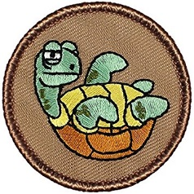
Banana Turtle Patrol
What patrol has been working on
Trips we let since last COH
Number scouts attending
What you did
Honors received since last COH (honor patrol)
Service you provided

Slide 3
Banana Turtle Advancement
Advancement
Who is leading the effort?
Summary of what you achieved (ie. 3 rank advancements 15 MB’s)
# Special Awards earned
Eagle scouts
Special Awards (ie. Purple Panda)

Slide 4
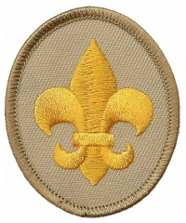
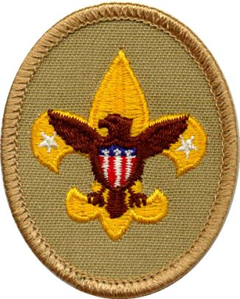
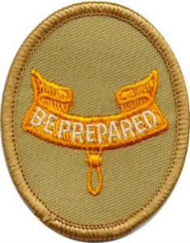
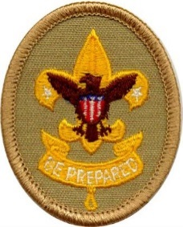
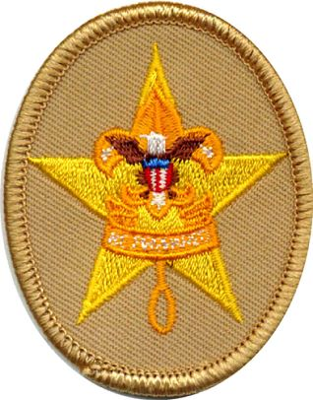
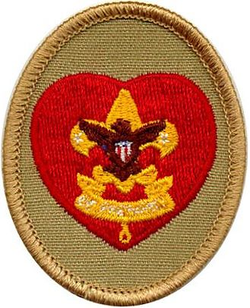
Banana Turtle Advancement
This Slide Provided to you…
Scout | Tenderfoot | Second Class | First Class | Star | Life
 | Josh Walsh |  | Matt Buczik | Andrew Embley | David Akins
 | David Howard |  | Gunnar Light |  | Sam Freer
 | Sal Nicoletti |  | Parker Dilworth |  | Joe Hackman
 |  |  |  |  | Edward Sommers

Slide 5
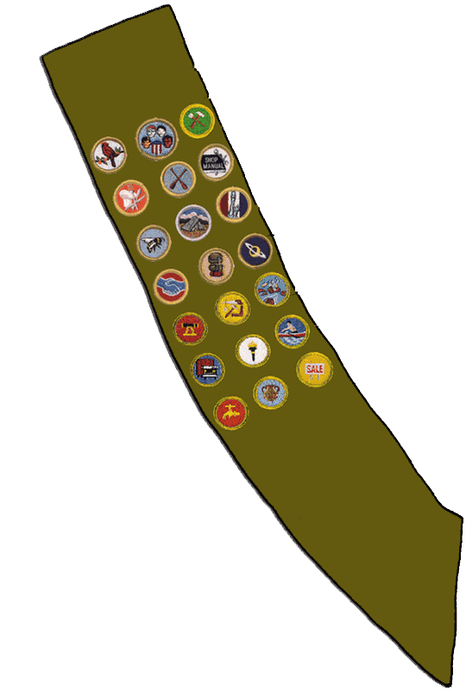
David Akins
Banana Turtle Merit Badges
A slide for each patrol member who earned a MB will be provided to you…
Environmental Science
Rifle Shooting
16 Total Merit Badges

Slide 6
Banana Turtle Other
Other information the patrol wants to add.
Upcoming trip promotion?
???
It’s ok to add photo’s of your trips here too!

